Slide 1

Project Prototype
By Giovanni Garcia Lopez and Allen Orozco

Slide 2
What is our project?
Our project is presenting an AirBNB.
The name of this project is ChillCrib which goes around the world.
Chill crib is a website where you can view many cribs you want to chill at.

Slide 3
Customer prototype
Customer prototype was designed by Gio. The design was based for what the customer wanted to view for each crib out there. The sub parts I was in charged were 8 parts for the customer.
Those subparts were:
Customer log in
Customer Sign up
Customer Dashboard
Being able to look at the crib details
Messages between the provider
Profile page
Subscription page

Slide 4
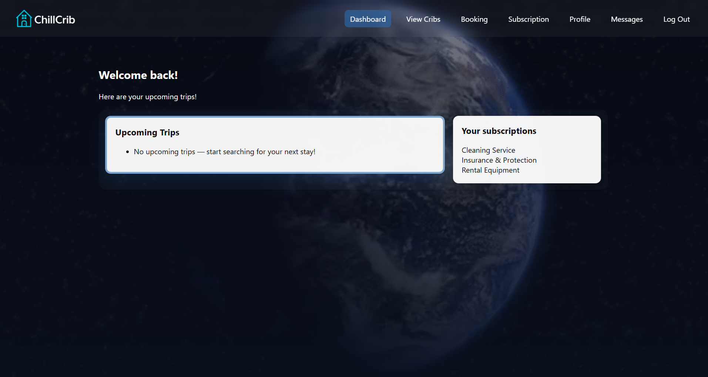
These were the subparts I created and was assigned to do
Here we can see what the customer dashboard looks like when they log in or sign up for the page. The top corner on the right is where the navigation bar is at and can see the cribs, to book, subscribe, view profile, look at messages, and as well log out.

Slide 5
Provider prototype
This was designed by Allen. The provider prototype is responsible for the customer to see what house they want and if they want to rent it. Those parts for the customer included sub issues.
Those sub issues were
Provider login screen
Provider sign up screen
Provider dashboard
Provider profile
Creating listing
Managing listing
Prototype listing

Slide 6
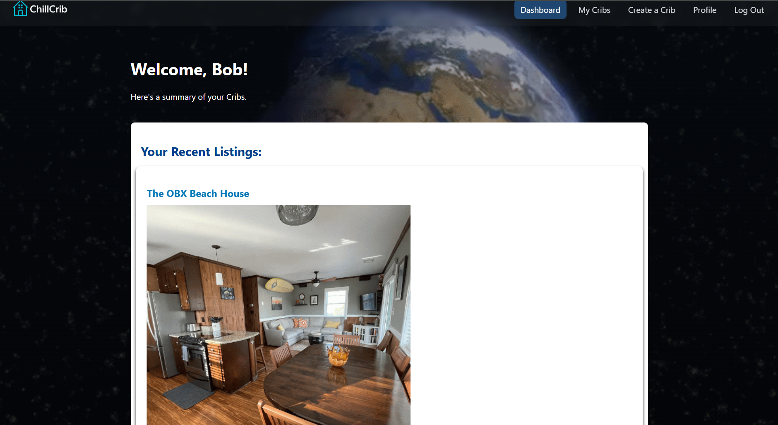

Slide 7

The end ☺

